Slide 1
Beautiful Family relation in Bangladesh
Md. Tauhid Ahmed
Roll No: 01-040-027
Batch: 40
Department of Accounting And Information Systems

Slide 2
In Bengali Muslim culture:
Father: Baba, Abba, Abbu
Mother: Maa, Amma, Ammu
Son/Daughter: Address by name
Brother (also male cousins): Bhai, Or Bhaiya
Brother's Wife: Bhabhi
Younger Brother: Bhai or by name
Sister (also female cousins) : Apu, or Apa, Affa, Api
Older Sister: Didi, Apu, or Apa

Slide 3
The Importance of Family in Bangladesh: Family is the cornerstone of Bangladeshi society, with close-knit relationships and traditions passed down through generations.
Influence of Nature on Family Dynamics: In Bangladesh, the natural environment—such as forests, mountains, and rivers—plays a significant role in shaping family connections and lifestyle.
Cultural and Emotional Ties: Families in Bangladesh share strong emotional and cultural bonds, often strengthened by the beauty and tranquility found in nature.

Slide 4
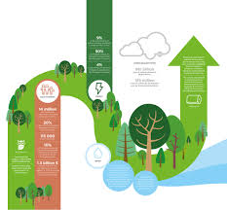
The Role of Forests in Family Life:
Sundarbans and Family Connections:
Traditional Livelihoods and Family Bonding:
Cultural Significance of Forests:

Slide 5

The Influence of Mountains on Family Values:
Chittagong Hill Tracts:
Community-Centered Living:
Rural Family Activities in the Hills:
Chittagong Hill Tracts:
Community-Centered Living:
Rural Family Activities in the Hills:

Slide 6

Rivers and Coastal Areas as Family Gathering Spots:
Coastal Life and Family Unity:
Rivers of Bangladesh:
Fishing and Family Collaboration:
The numerous rivers, such as the Ganges, Brahmaputra, and Meghna, serve as vital sources of livelihood and recreation. Families in Bangladesh often come together near rivers for festivals, leisure, and spiritual activities.
Families living near the coastal areas, like those in Khulna or Cox's Bazar, maintain close relationships with the sea. The ocean's vastness creates a shared sense of awe and unity among family members.
In many riverine and coastal regions, fishing is a family activity. Generations of family members work together, creating a bond through the shared experience of fishing and boat travel.

Slide 7
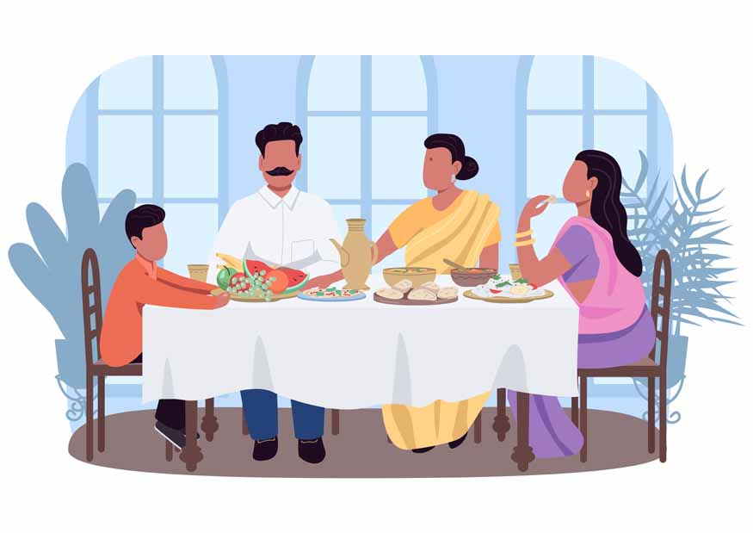
How Cultural Practices Bind Families Together:
Celebrations and Festivals: Bangladesh is known for its vibrant cultural festivals, such as Pohela Boishakh (Bengali New Year), Eid, and Durga Puja. These festivals offer families a chance to gather, celebrate, and strengthen their bonds through shared traditions and rituals.
Family Traditions Passed Through Generations: Many families in Bangladesh practice traditions that have been handed down for generations, from religious ceremonies to cultural dances. These traditions help maintain the emotional and cultural connections between family members.
Community Celebrations: Festivals are not only a time for individual families to celebrate, but they also provide an opportunity for extended families and entire communities to come together, reinforcing the social fabric of Bangladeshi society.

Slide 8

Family Life in Rural Communities:
Rural Family Structure: In rural Bangladesh, families tend to be large, with extended family members often living in close proximity. This living arrangement strengthens intergenerational bonds, with children learning from grandparents, uncles, and aunts.
Shared Responsibilities: In rural areas, families often share household and farming responsibilities. This communal approach fosters teamwork and mutual support, where each family member plays a vital role in the family’s survival and well-being.
Family-Centered Rural Economy: In rural communities, family businesses, such as farming, small-scale trade, or handicrafts, are common. These family-owned businesses often stay within the family, promoting long-lasting connections and economic security for future generations.

Slide 9
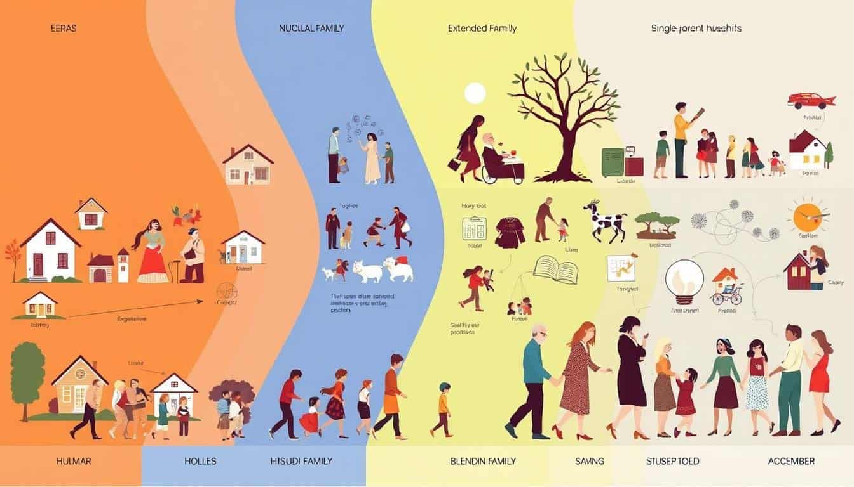
Changes in Family Structures and Relationships:
Urbanization and Family Life: With rapid urbanization, families in cities like Dhaka are experiencing changes in structure and relationships. While nuclear families are becoming more common, traditional values still play an important role in shaping family dynamics.
Challenges of Modern Urban Life: In urban Bangladesh, the pressures of work, education, and social expectations can sometimes strain family relationships. However, the strong sense of familial duty and respect for elders often helps families navigate these challenges.
Balancing Tradition with Modernity: Many urban families are finding ways to balance modern lifestyles with traditional family values. This includes maintaining close relationships with extended family members and participating in cultural events despite the demands of urban life.

Slide 10
The Everlasting Strength of Family Bonds in Bangladesh Summary of Key Points:
Family as the Foundation of Society: | Whether in rural or urban settings, family remains the core unit of society in Bangladesh, providing emotional, cultural, and financial support.
Nature’s Role in Strengthening Bonds: | The forests, mountains, rivers, and oceans of Bangladesh create environments where family bonds are nurtured, through shared activities and communal living.
Cultural Traditions and Modern Challenges: | Despite modern challenges, cultural practices, festivals, and family-oriented traditions continue to shape and strengthen familial relationships.
The Future of Family in Bangladesh: | As Bangladesh continues to modernize, the importance of family remains undiminished, adapting to changing times while preserving core values.

